Slide 1
Raspberry Pi OS
By:
N MADHU SUDHAN

Slide 2
Set Up a Headless Raspberry Pi

Slide 3
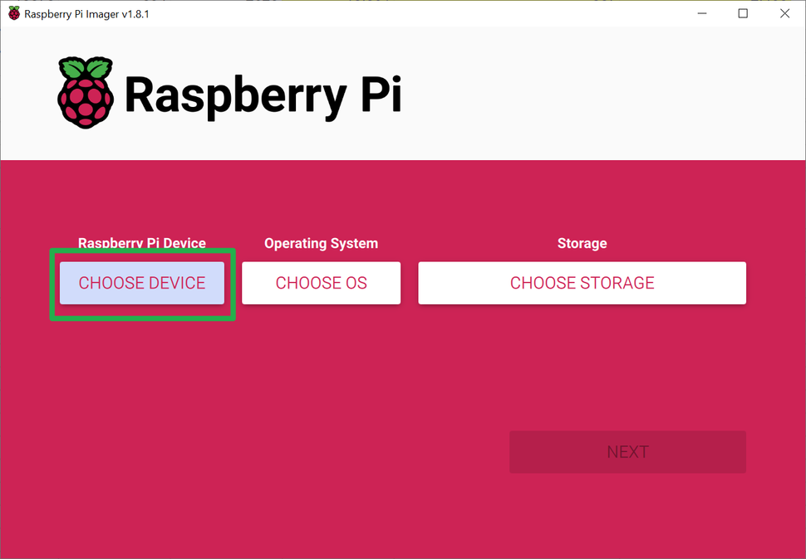

Slide 4
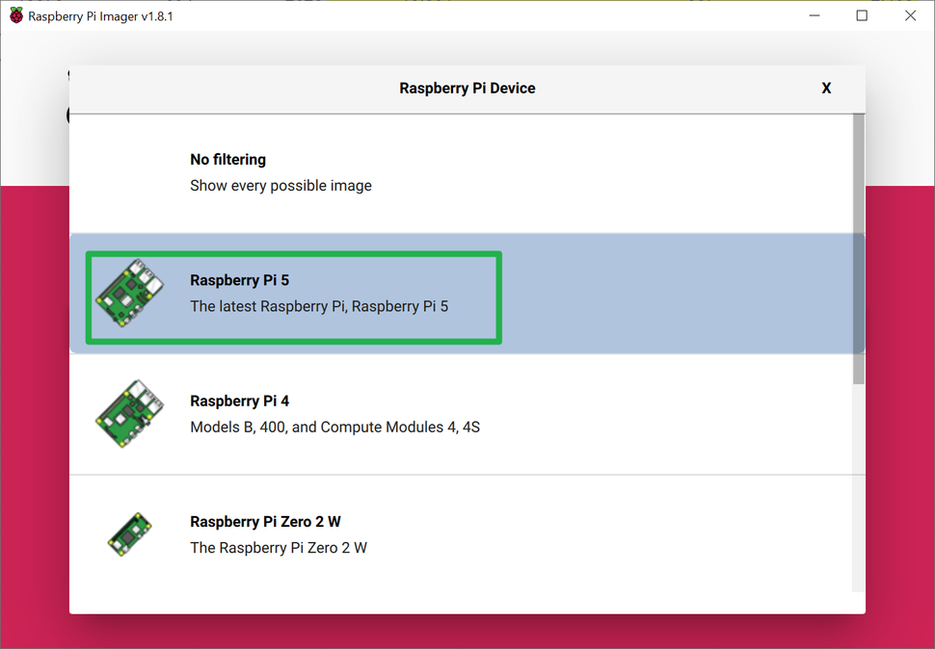

Slide 5
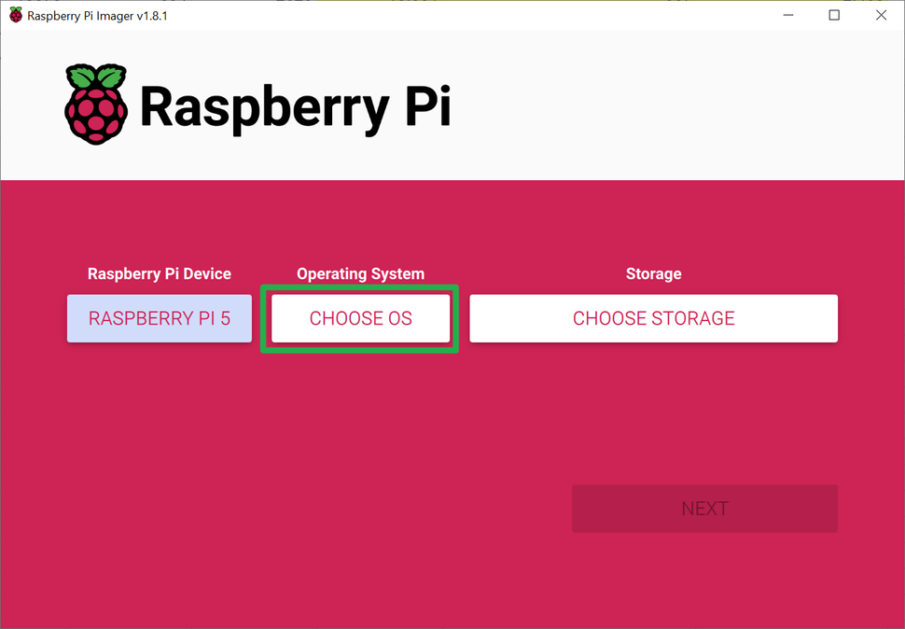

Slide 6
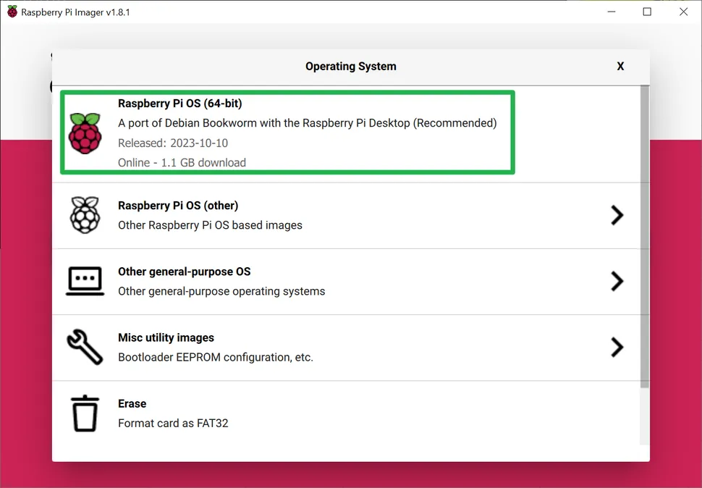

Slide 7
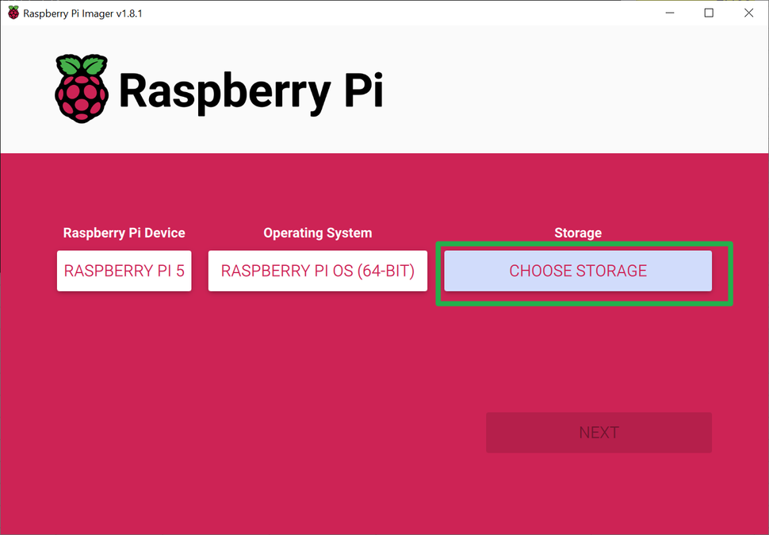

Slide 8
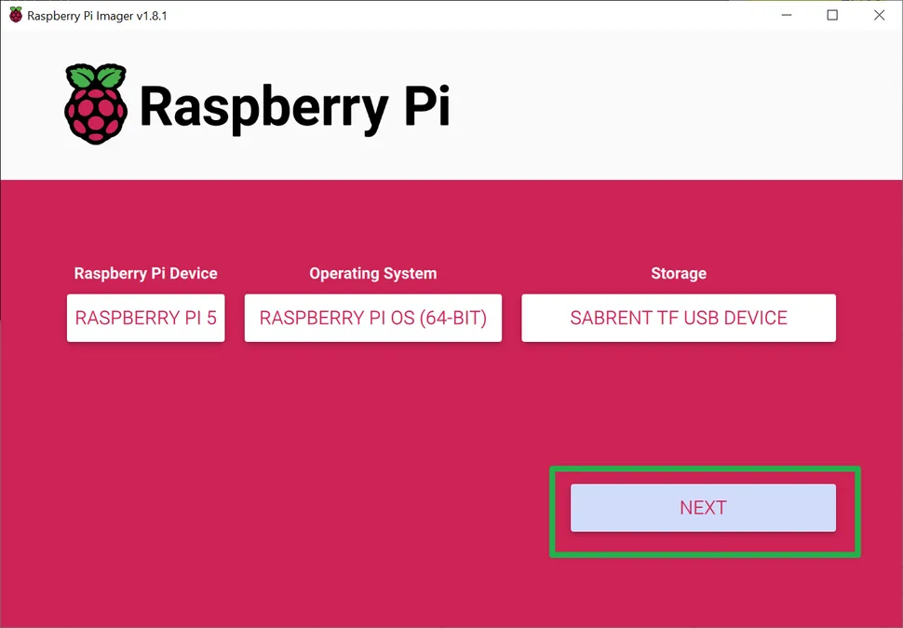

Slide 9
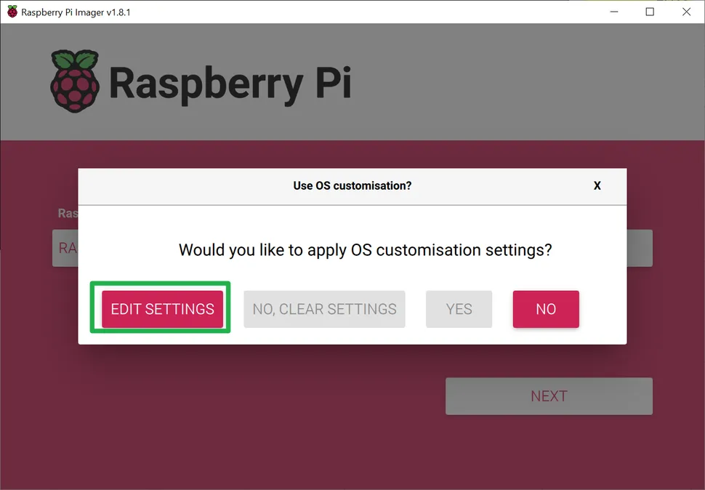

Slide 10
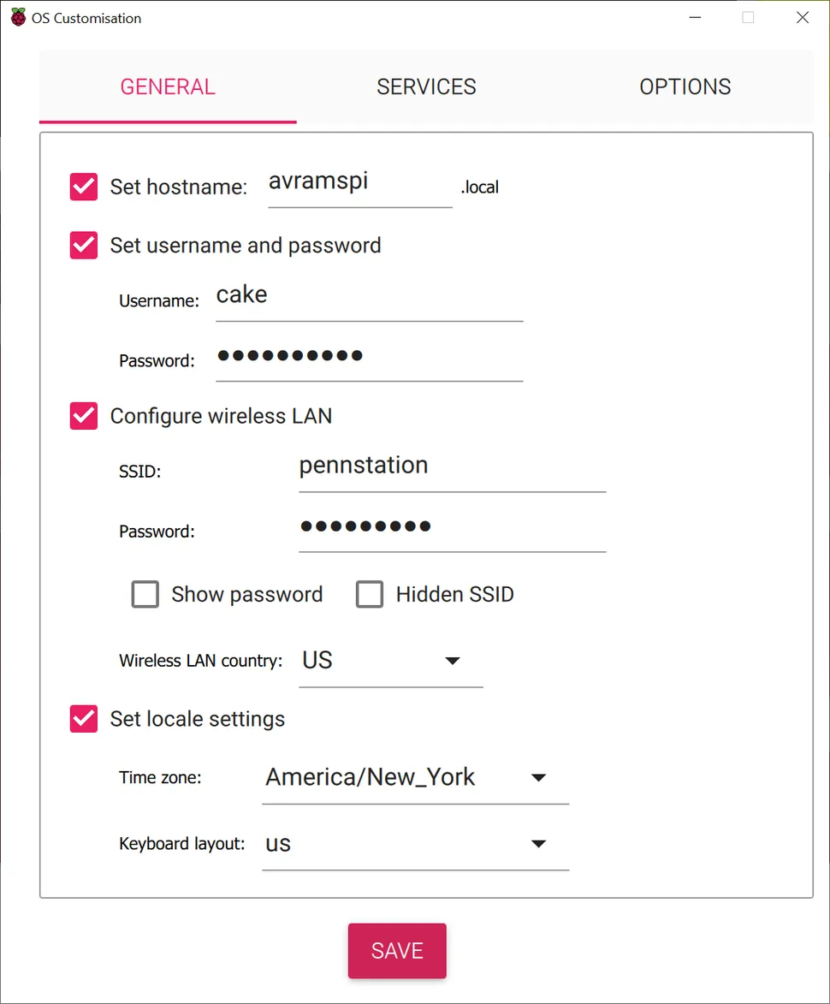

Slide 11
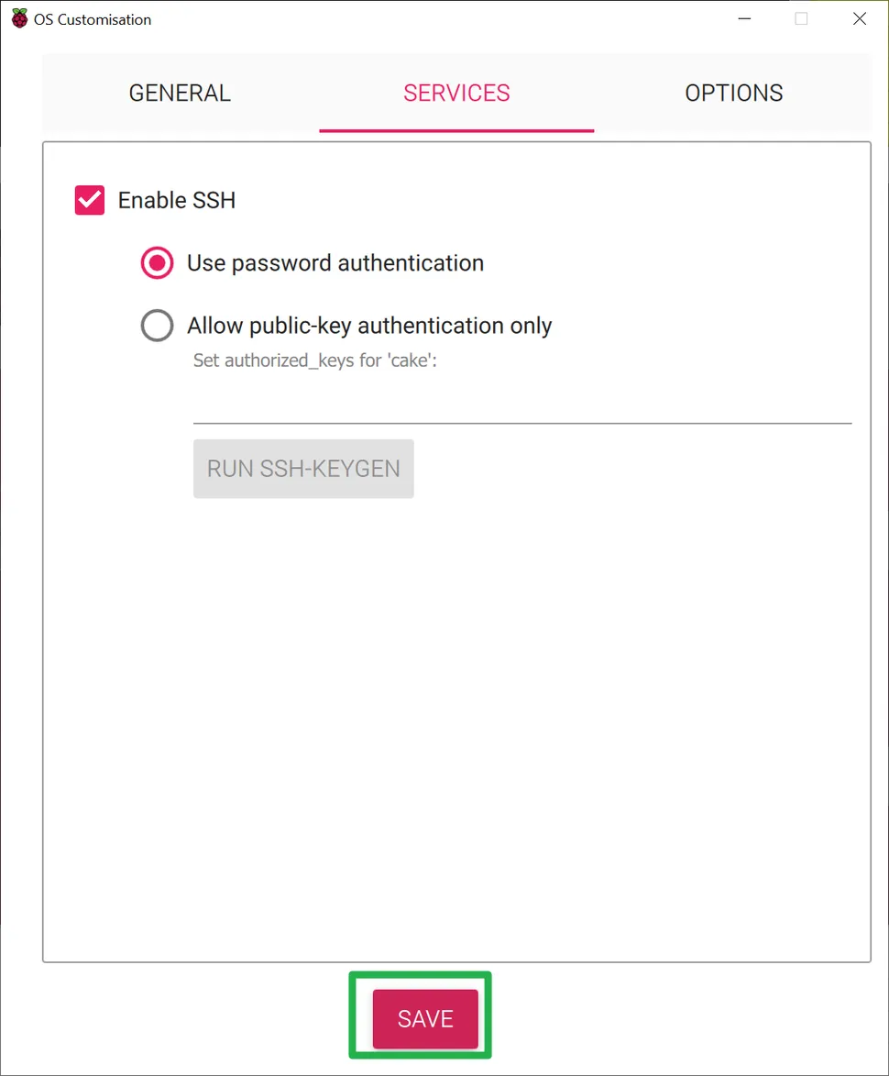

Slide 12
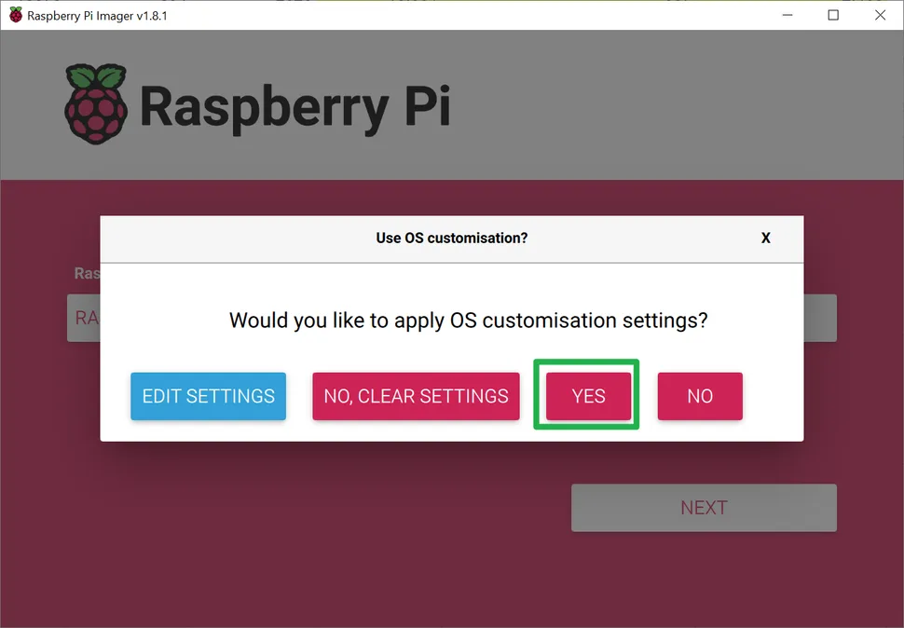

Slide 13
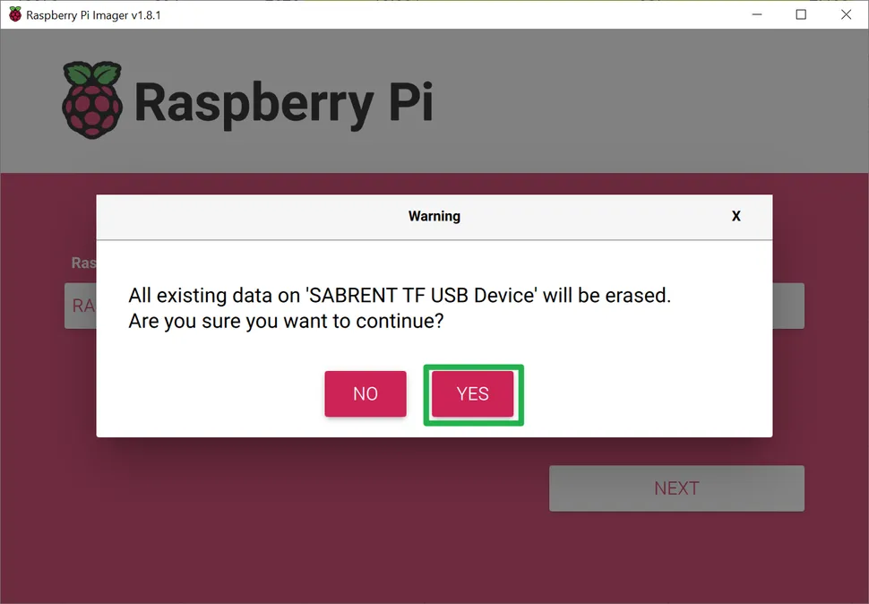

Slide 14
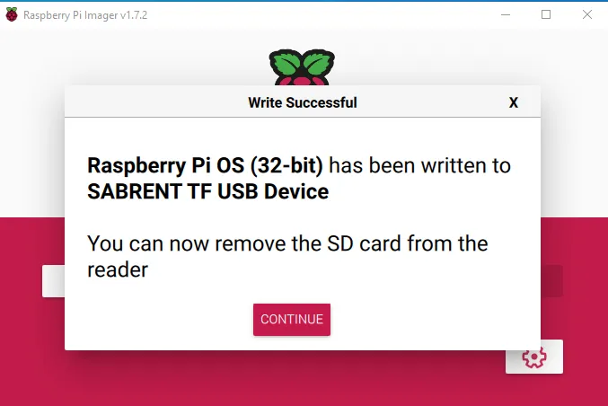

Slide 15
Connecting to Your Pi via SSH

Slide 16
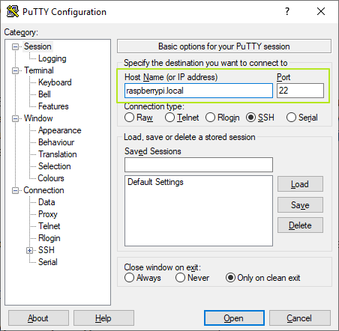

Slide 17
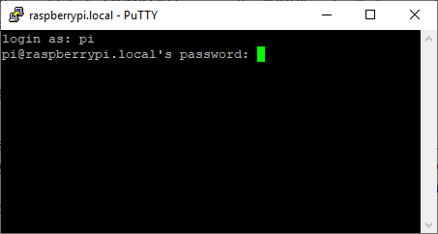

Slide 18
Enabling VNC

Slide 19
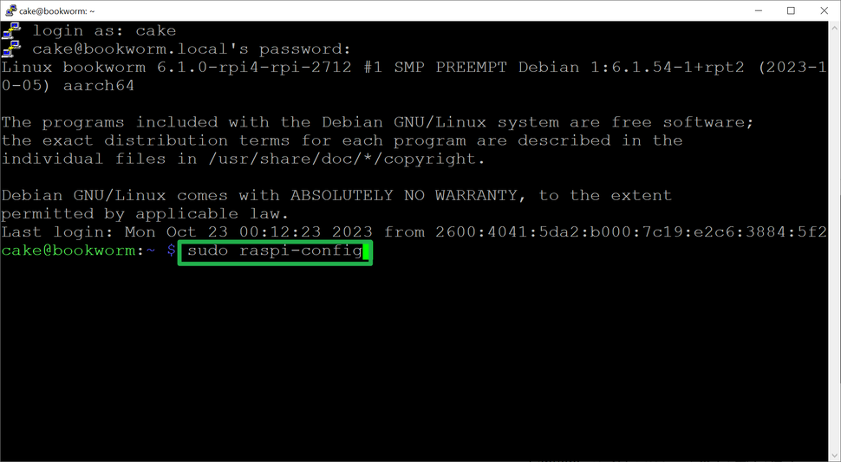

Slide 20
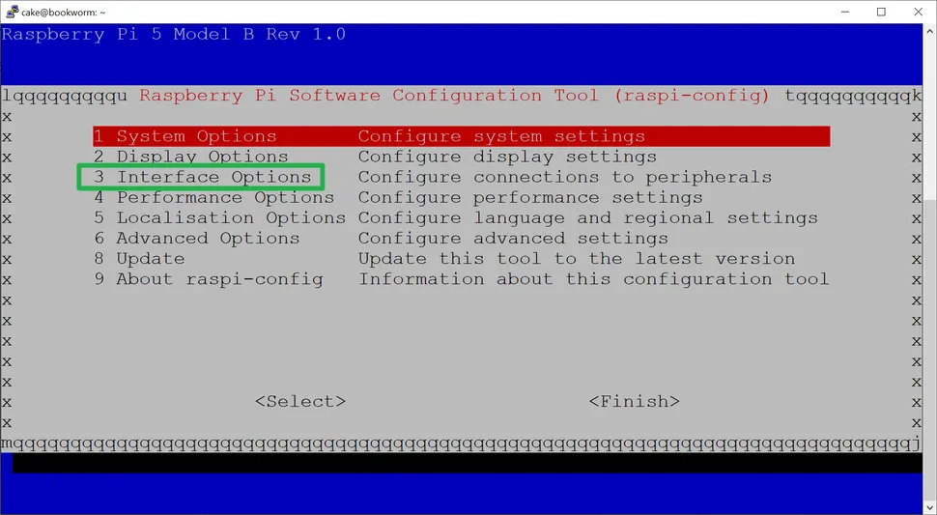

Slide 21
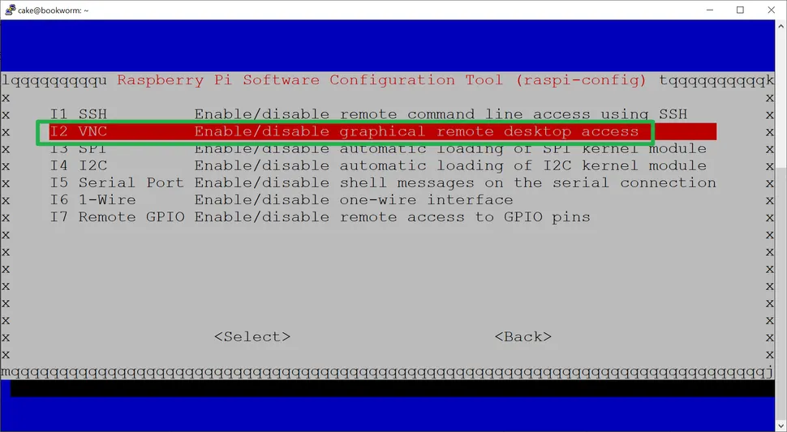

Slide 22
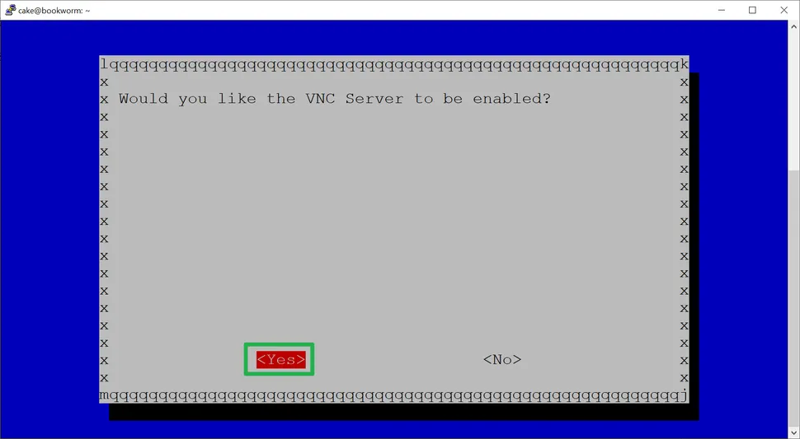

Slide 23
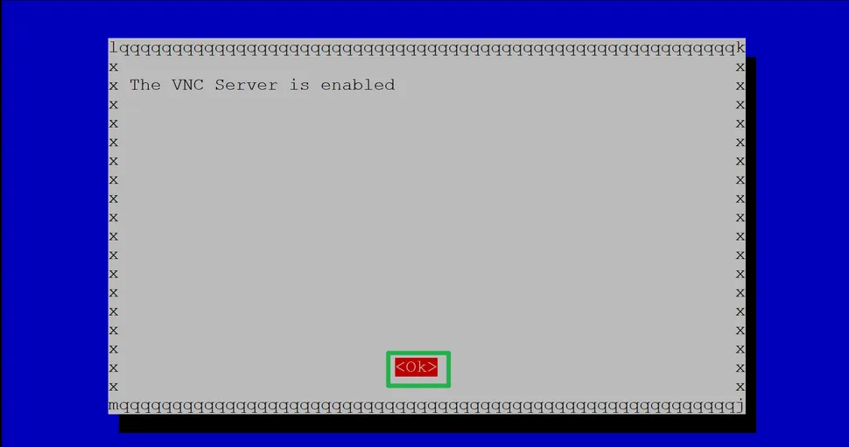

Slide 24
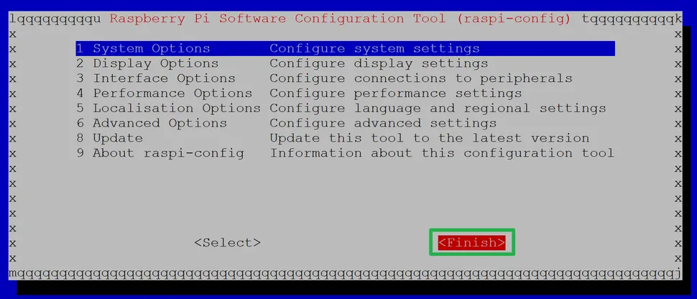

Slide 25
Connecting over VNC

Slide 26
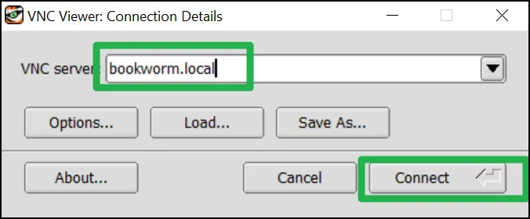

Slide 27
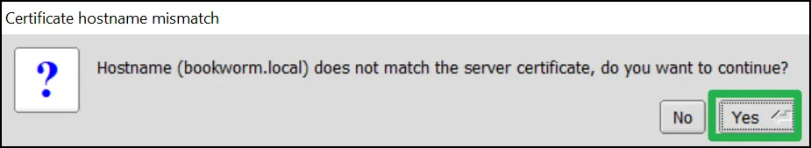

Slide 28
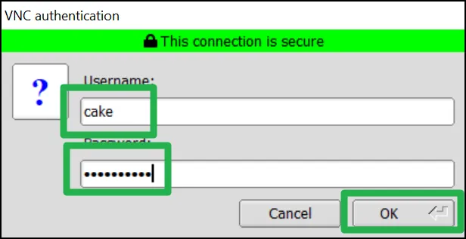

Slide 29
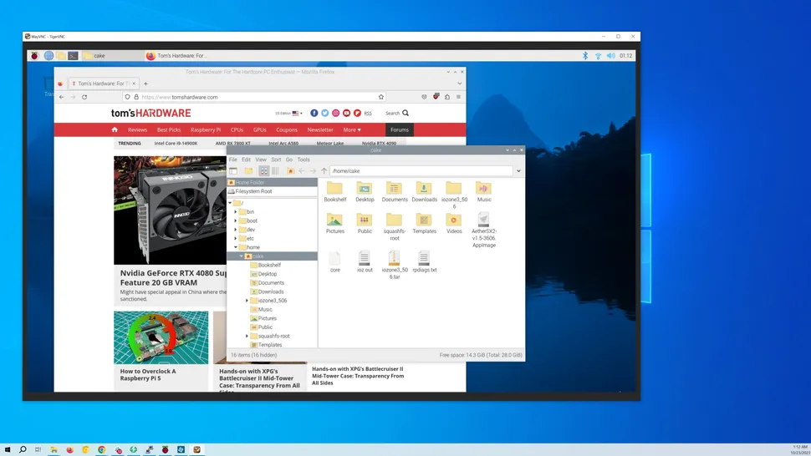

Slide 30
Editing Wi-Fi on a Pre-written
Create a text file called wpa_supplicant.conf
Place it in the root directory of the microSD card
country=US
ctrl_interface=DIR=/var/run/wpa_supplicant GROUP=netdev
update_config=1
network={
scan_ssid=1
ssid="your_wifi_ssid"
psk="your_wifi_password"
}

Slide 31
Thank You

